Slide 1

Customer Churn Prediction In Telecom Industry
By : A.RAVINDER

Slide 2
Churn prediction detecting customers who are likely to cancel a subscription to a service. Churn is a problem for telecom companies because it is more expensive to acquire a new customer than to keep your existing one from leaving.
Procedure
Identify Problem Statements.
Data Collection
Exploratory Data Analysis
Feature Engineering
Feature Selection
Handling Imbalance Data
Model Selection
Create and Deploy App

Slide 3
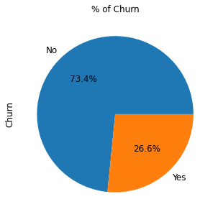
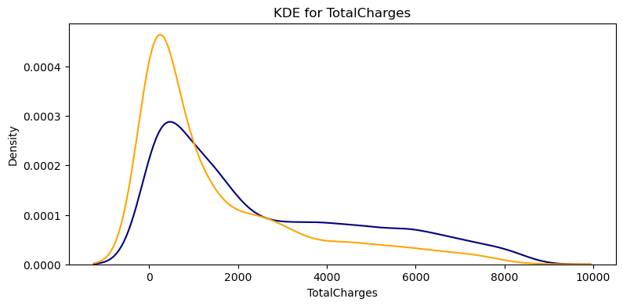
EDA
From KDE Plot
Recent clients are more likely to churn.
Clients with higher Monthly Charges are also more likely to churn.
Tenure and Monthly Charges are probably important features.
From boxplot
75% of churners pay between 60 and 100 dollars a month
One important mark we can see in this plots that 50% of Churners leave the company before the first year goes by.

Slide 4
Gender - The churn percent is almost equal in case of Male and Females
The percent of churn is higher in case of senior citizens
Customers with Partners and Dependents have lower churn rate as compared to those who don't have partners & Dependents.
Churn rate is much higher in case of Fiber Optic Internet Services.
Customers who do not have services like No OnlineSecurity , Online Backup and TechSupport have left the platform in the past month.
A larger percent of Customers with monthly subscription have left when compared to Customers with one or two year contract.
Churn percent is higher in case of customers having paperless billing option.
Customers who have Electronic Check Payment Method tend to leave the platform more when compared to other options.

Slide 5
Feature selection
Revenue analysis
Drop customer ID column
For feature selection used chi2 test
Gender, Multiplelines, Phone Servies have greater p-value, so null- hypothesis rejected also in survival curve there is no importance.
Drop columns with 0.9 of correlation
1.DeviceProtection_No internet service
2.OnlineBackup_No internet service
3.OnlineSecurity_No internet service
4,StreamingMovies_No internet service
5.StreamingTV_No internet service
6.TechSupport_No internet service
31% of total revenue was "lost" by people who left.
Optical fiber is responsible for 53% (168,99k) of the monthly revenue, DSL 37% (118,14k)
87% of all monthly revenue lost are caused by customers with Month-to-Month Contracts

Slide 6
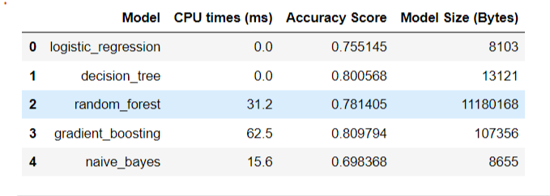
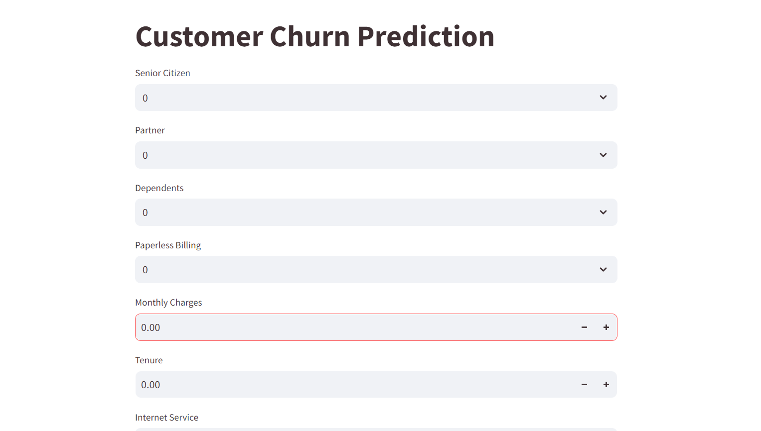
Best Models:
Deployment:Streamlit
Easy-to-Use Interface: Simple and interactive UI.
Instant Predictions: Get real-time predictions from the model.

Slide 7
Reduce Telecom Customer Churn :
Use the App to predict churn probabilities
Engage with your customers
Define your most valuable customers
Give better service
Pay attention to complaints
Make your best people deal with customers at risk
Flaunt your competitive advantages
Offer long term contracts

